Slide 1
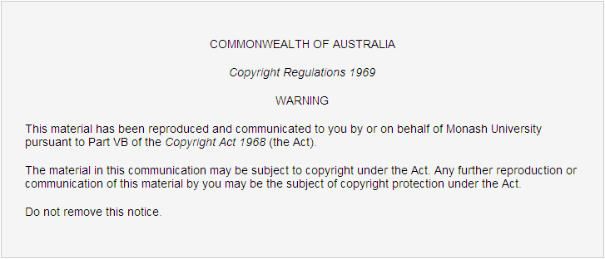
FIT3031 INFORMATION & NETWORK SECURITY

Slide 2
FIT3031 INFORMATION & NETWORK SECURITY
Unit Information

Slide 3
Outline
People involved
Unit objectives
Resources
Unit structure
Tutorials
Assessment
Responsibilities

Slide 4
People Involved
Caulfield Campus
Lecturer
  Dr. Abdul Malik Khan
    Building 63, 25 Exhibition Walk
    Email: Malik.Khan@monash.edu
    Consultation time: TBA
Tutors
  Sepehr Minagar
  Sarah Fathima

Slide 5
Unit Objectives
Principles and practice of information & network security standards and protocols
Methods and their effectiveness in achieving the security properties
Application of those methods for security of information & network systems with emphasis on the Internet and corporate networks
Notes:
The explosive growth of computer systems and their interconnections via networks has increased the dependence of both organizations and individuals on the info stored and communicated using these systems.

Slide 6
Unit Objectives: Why study information and network security?
Students should be able to:
  describe OSI security architecture
  describe common security standards and protocols for network security applications e.g. electronic mail, IP, web and network management
  understand common information risks and requirements
  explain the operation of conventional and public-key encryption techniques
  describe the concepts and techniques for digital signatures, authentication and non-repudiation
  appreciate the need for the digital certificates and public key infrastructure
  appreciate the importance of system security against intruders and malicious software using firewalls
  apply simple security configurations to PC based applications e.g. email, Internet, computer administration
  design information systems with security compliance
Notes:
In this age of universal electronic connectivity , of viruses and hackers, of electronic eaves dropping and electronic fraud there is no time when security does not matter.
The growth of computer systems and networked connectivity has increased the dependency of organisations on these for their normal operations. There fore the need to protect info and resources from breach of security is very important.
Cryptography & network security has matured and practical solutions are now avaialble to enforce info & network security.
Hence we need to study these.
The Open Systems Interconnection Basic Reference Model (OSI Reference Model or OSI Model for short) is a layered, abstract description for communications and computer network protocol design, OSI seven layer model. 7 Application layer 6 Presentation layer 5 Session layer 4 Transport layer 3 Network layer 2 Data link layer => * LLC sublayer * MAC sublayer 1 Physical layer
OSI security arch defines a systematic approach to defining the security requirements and methods of satisfying them.

Slide 7
Resources: MUSO
Moodle 2
Unit information:
  You will find the information on Moodle
Study guides and lecture notes
Tutorials and laboratory exercises
Assignment specifications
Newsgroups/discussion areas
Additional support material
Notes:
http://moodle.vle.monash.edu/mod/url/view.php?id=2755911

Slide 8

Resources: Textbooks and Software
Textbook
  Network Security Essentials-Application & Standards”, 5th Edition
  Author: William Stallings
    ISBN: 0133370437
    Publisher: Prentice Hall
    Copyright: 2013
    Format: Paper; 432 pp
    Published: 2013
Supplementary textbooks
  Can be used as additional
  support material by students
Software
  Various software simulators
  and tools (see the unit website)
Notes:
Lecture notes do provide some learning material. Please do not rely solely upon the lecture notes for your learning - they are just 'notes' after all. You are expected to read (and understand!) the text book as well - there is much background material that cannot be covered in lectures.
William Stallings. (2013).
Network Security Essentials: Applications and Standards.
. (5th Edition)
Pearson International. (ISBN: 0133370437).
NETWORK SECURITY ESSENTIALS, FIFTH EDITION
New topics for this edition include SHA-3, cloud security, network access control, personal identity verification (PIV), and mobile device security. ISBN: 0133370437

Slide 9
Resources: Other Materials
Study Guides and Lecture Notes
  12 Study Guides and Lecture Notes
    Learning objectives / guided reading
    Supporting information for lectures
On-line resources on the web

Slide 10
Unit Structure: Lecture Topics
OSI security architecture
  common security standards and protocols for network security applications
  common information risks and requirements
operation of private and public key encryption techniques
concepts and techniques for digital signatures, authentication and non-repudiation
security threats of email systems and web servers, and their possible countermeasures
IP security
Wireless security issues
risk of malicious software, virus and worm threats, and countermeasures
intrusion detection techniques and network management protocol for security purpose
firewall deployment and configuration to enhance protection of information assets
Notes:
This unit looks at a range of security problems in information systems, namely system security, network security and software security. Within these areas, topics covered include properties of information security, principles of encryption, a variety of crypto techniques and analysis, and their application to practical examples like authentication algorithms, non repudiation by digital signatures among others. It looks at various management issues, including disparate application examples, distributed systems authentication, contingency planning, audit and review, intrusion detection to name a few.

Slide 11
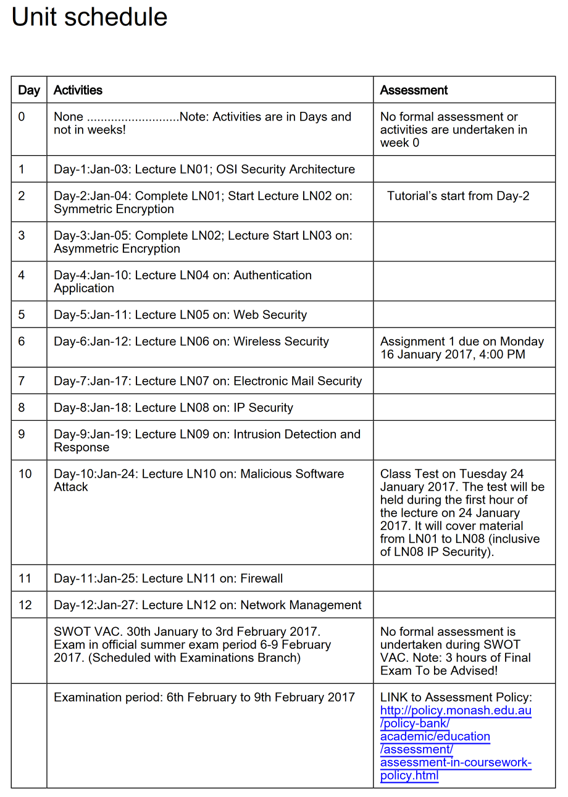

Slide 12
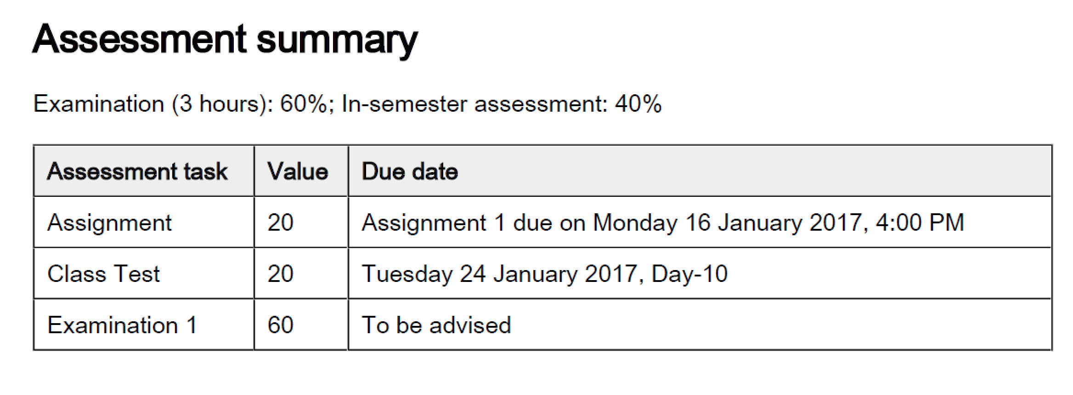

Slide 13
Caulfield Unit Structure: Timetable
Lecture: 3 lectures / week
Tutorial: 3 tutorials / week
  – 2 hrs. each tutorials
  see Allocate+
Reading:
– Text Book
– Other resources on the unit page
Student Workload
  13 hours Lectures & Tutorial classes each week
  24 hours of personal study to satisfy the reading and assessment expectations.
Notes:
Attendance will be taken in tutorials. It is your responsibility to attend.

Slide 14
Assessment
Assessment
Non-Exam component
  Assignment-1: 20% & Class Test: 20%
  Hurdle of 16 out of 40
Final Exam: 60%
  Hurdle of 24 out of 60
To pass FIT3031
  You must submit assignment-1 and pass Class Test
  Your marks must average to at least 50
  You must pass each individual hurdle
Failure to meet a hurdle will result in a maximum mark of 44N

Slide 15
Assessment: Assignment & Class Test
Assignment 1
– Due Date: Friday 16th January 2017, 4:00 PM
– Weighting 20 %
Class Test
– Due Date: Day-10 Tuesday 24th January 2017 during the first hour of (Lecture)
– Weighting 20 %
Assignment details will be posted on the web
Late Assign submission ONLY with prior permission and VALID reasons
Notes:
Factors such as normal work pressures, vacations, etc. are seldom regarded as appropriate reasons for granting extensions. Students are advised to NOT assume that granting of an extension is a matter of course.
If an assignment will be late, it is necessary to contact the unit adviser of your campus at least 2 days before the due date. You may be required to provide documentation to support a request for late submission. There may be a penalty of 3% for each day of late submission if not approvaed before due date.

Slide 16
Assessment: Final Exam
3 hour closed book examination
60 % of total marks
will test your knowledge in the unit matter outlined in the SG objectives
Final Exam for FIT3031: TBA
Check Exam timetable on my.monash….

Slide 17
Responsibilities: Students
Prepare and deliver lectures
Advertise:
  Consultation hours
  Method of assessment
Minimize noise & distraction
  Do not talk in lectures
  Do not pack up early
  Turn off your mobile phone
Attendance
  Attend all lectures and tutorials ( each 12 hours/week)
Prepare in advance for Lectures and Tutorials (24 hours/week)
Seek assistance if you are having difficulties

Slide 18
Unit: General Information
Studying is your responsibility
  You are in charge of
    Lecture and tutorial
      attendance
      preparation
    handing in assignments
    checking whether your marks have been recorded
Lecturers are not “teachers”
  Lecturers do teaching, research and admin
The subject “ramps up” quickly
  Make sure you keep up!
Notes:
Nobody will check whether you attended lectures
Nobody will chase you for your assignments
In addition, you may not know many students. We will try to help out by introducing people during pracs and tutes, but you should make an effort to join in and meet people. This is not just for a social purpose, but your classmates can help you study.

Slide 19
Do you have a disability or long/short term medical condition that impacts on your study?
The Disability Liaison Unit (DLU) provides a range of services to assist students who have a disability or long/short term medical condition
To register with the DLU, students must be enrolled in an award course at Monash University and provide relevant, current documentation from a qualified professional
The DLU can be contacted via email dlu@adm.monash.edu.au or phone 9905 5704
For further information see www.adm.monash.edu.au/sss/equity-diversity/disability-liaison

Slide 20
Seek Assistance as a preventative measure
Discuss any study difficulties you are experiencing
  course leader or lecturer
Language and learning online has resources that can help you with study methods, language skills and work presentation to improve your performance. http://www.monash.edu.au/lls/llonline/
Seek assistance from the University Counseling Service if you think personal or other issues may be affecting your level of achievement. http://www.adm.monash.edu.au/community-services/counselling/index.html
Access for additional support or help: Monash University Student Support Services Contact List http://www.infotech.monash.edu.au/resources/student/

Slide 21
Next Lecture Topic
Lecture Topic 1
  Introduction to Information and network security

